Slide 1
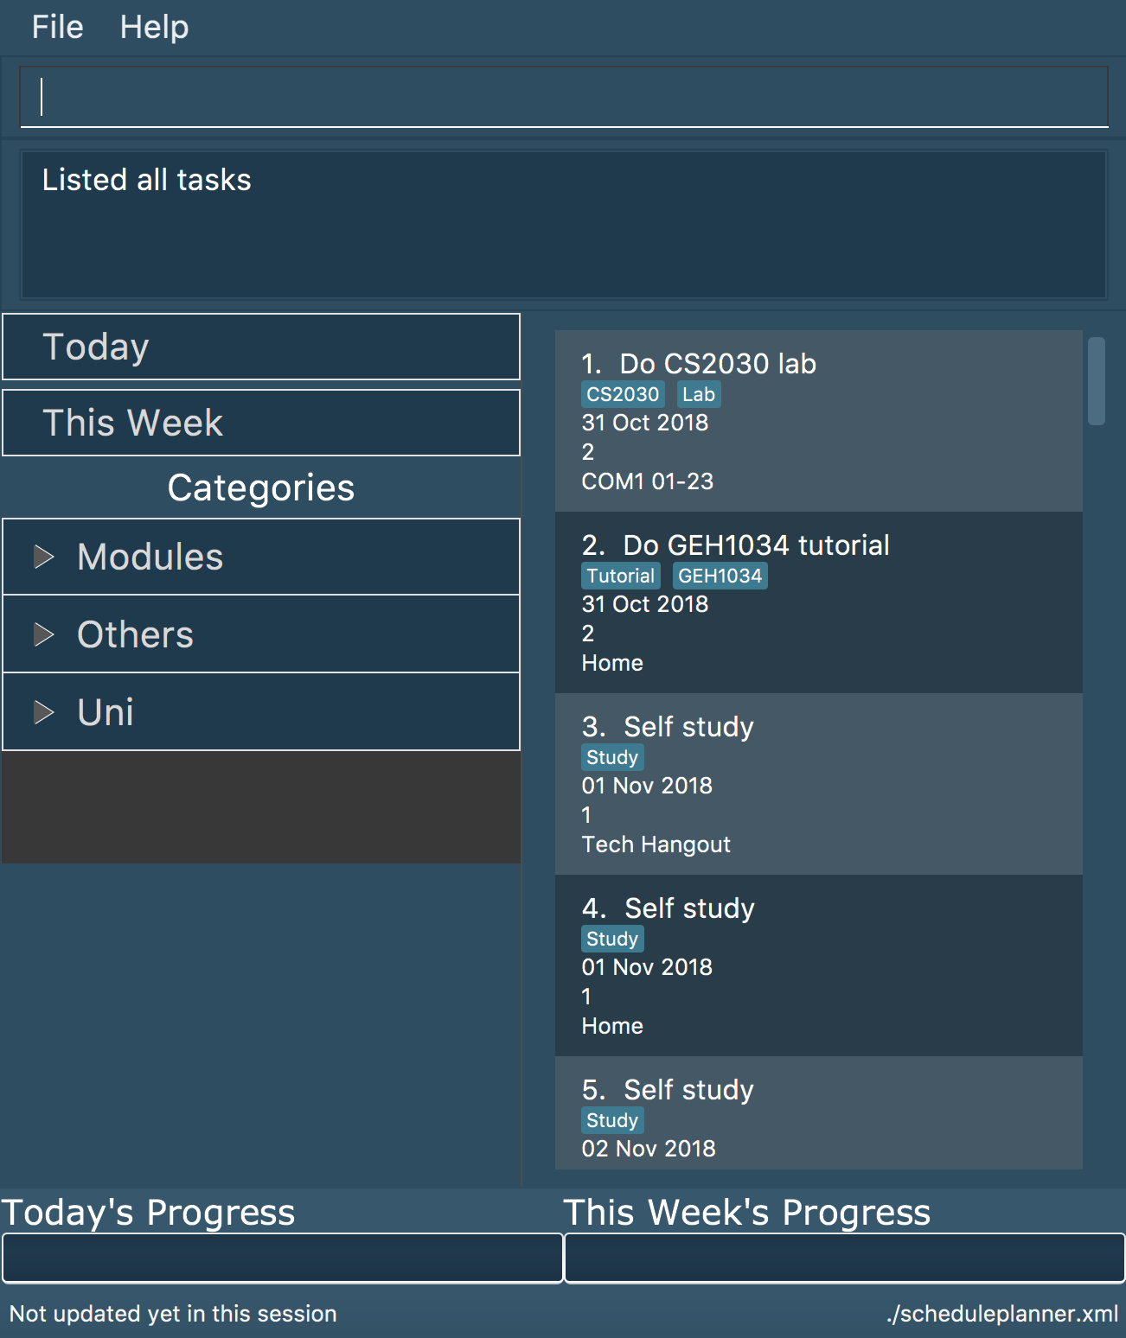
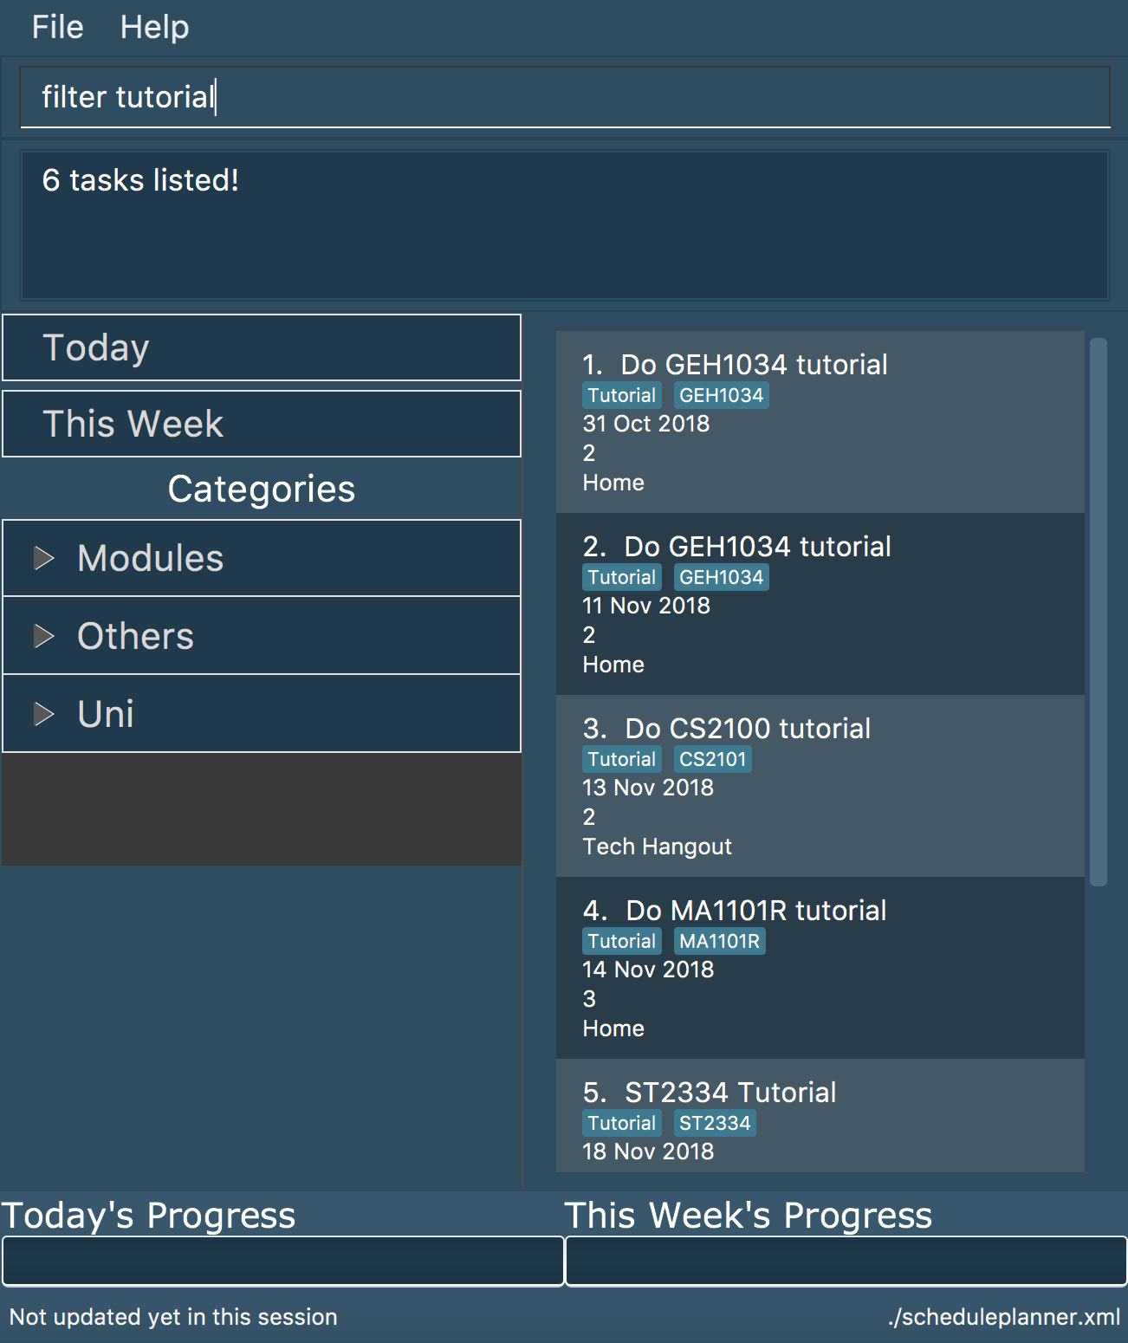
Before
After ‘filter tutorial’
filter tutorial

Slide 2
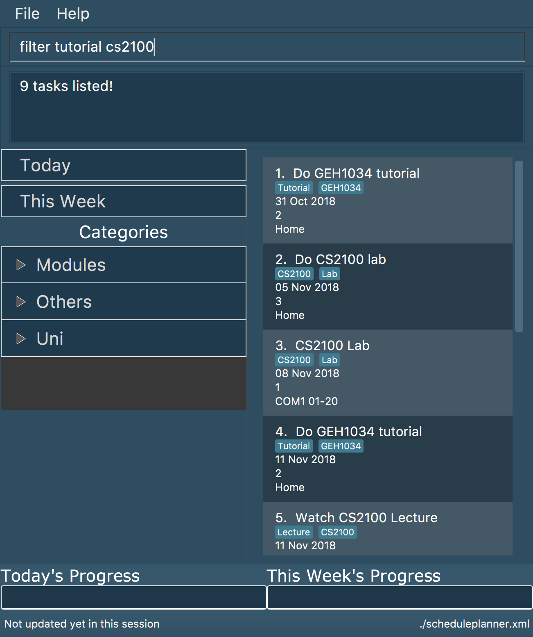
Before
After ‘filter tutorial cs2100’
filter tutorial cs2100

Slide 3
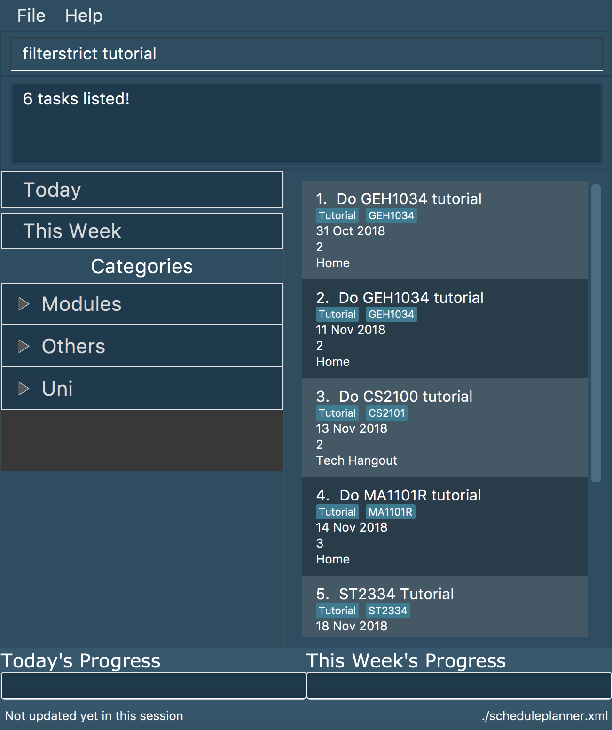
Before
After ‘filterstrict tutorial’
filterstrict tutorial

Slide 4
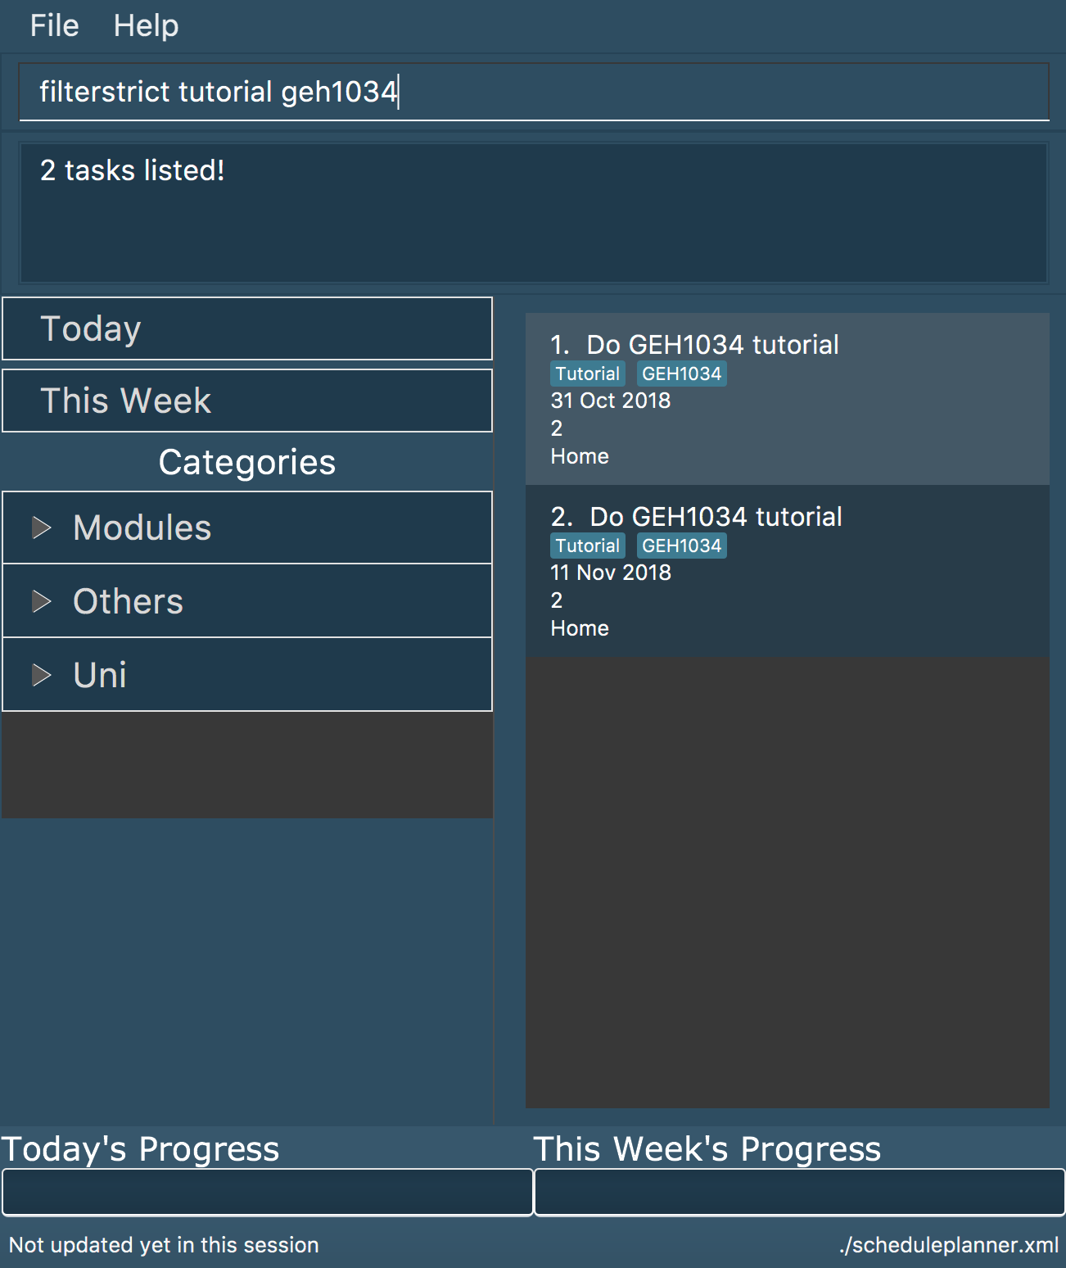
Before
After ‘filterstrict tutorial geh1034’
filterstrict
tutorial geh1034

Slide 5
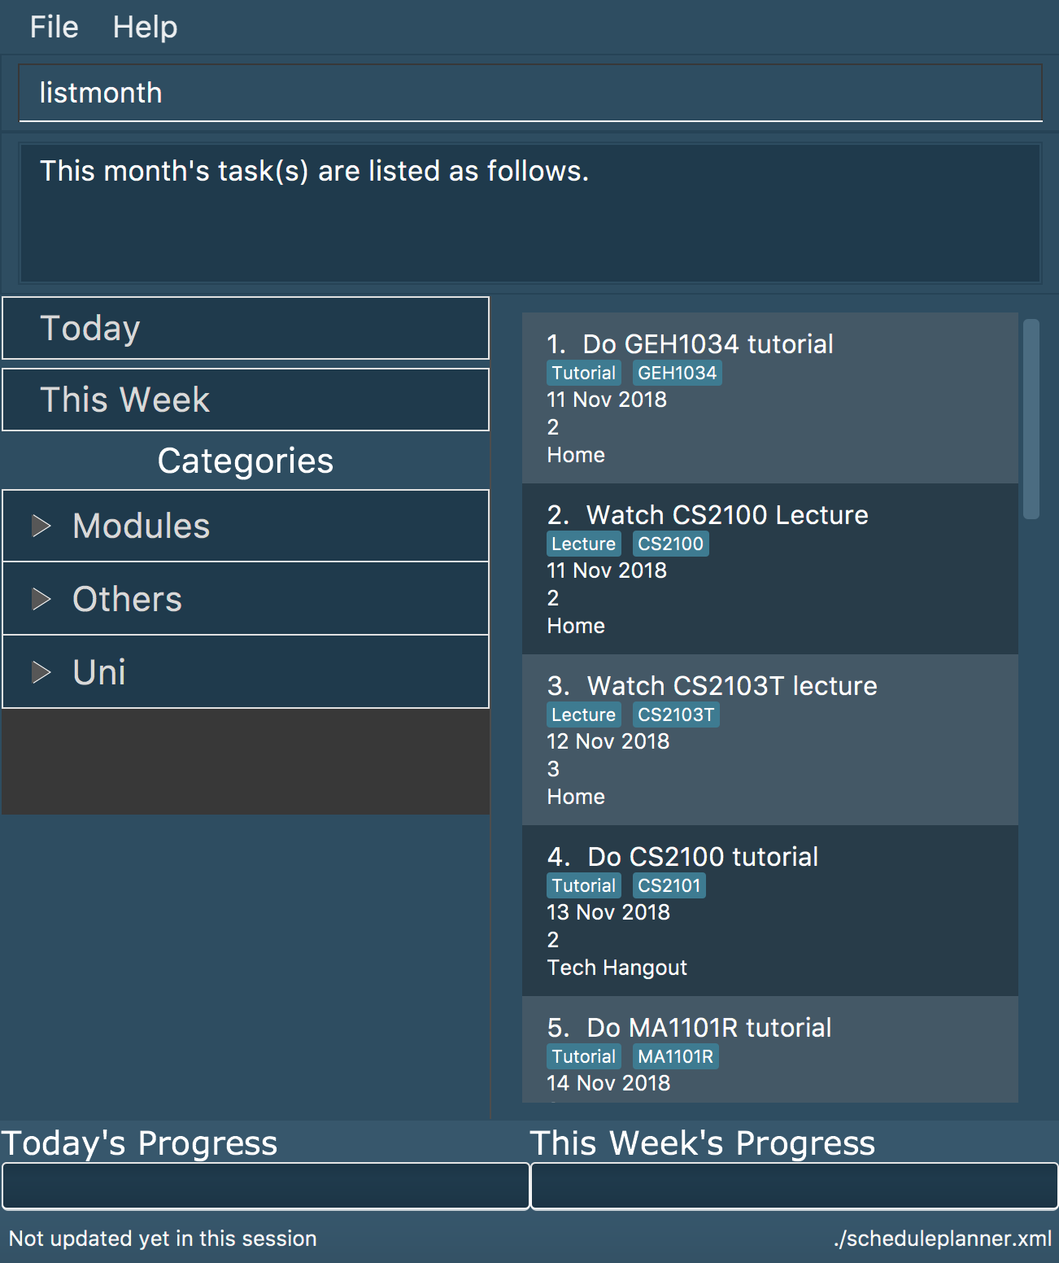
Before
After ‘listmonth’
listmonth

